Slide 1
Lecture 6

Slide 2
Question
The power delivered by a wave is proportional to
The position of the end of the wave
The mass of the medium
The amplitude of the wave squared
The period of the wave squared

Slide 3
Δm

Slide 4
Question 223.4.5 123.22.1
A 60W light bulb is allowed to burn for 3600s. How much energy has been used?
36000J
72000J
144000J
216000J
5400000J

Slide 5
Question 223.4.6 123.22.2
Suppose I do 50J of work in two hours, then I do 50J of work in one hour. For which set of work was the power larger?
The first
The second
They are the same
Neither amount of work had power associated with it.

Slide 6
Question 223.4.8 123.22.4
If you cup your hand to your ear, you can hear better. This is because
You change the frequency of the sound with your hand
You increase the collection area
You increase the amplitude of the wave
Can’t tell

Slide 7
For which professor is the sound louder?
Point Source
Professor A
Professor B

Slide 8
Intensity
r
Point Source

Slide 9
For which professor is the sound louder?
Point Source
Professor A
Professor B

Slide 10
Question 223.4.7 123.22.3
Tuning Fork: Which tuning fork is louder, the
mounted one
free one

Slide 11
Intensity in W/m²
Distance in meters

Slide 12
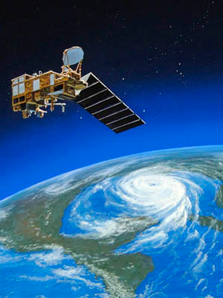
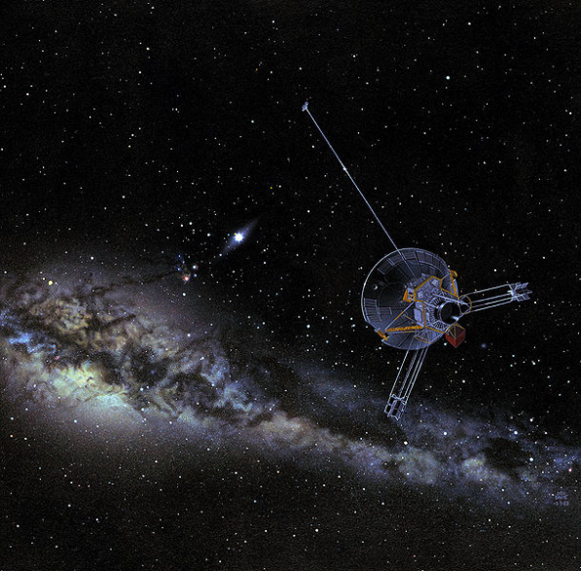
Question 223.4.9
The Pioneer 10 spacecraft has a large dish antenna, the Earth Observation System spacecraft has a much smaller antenna. Why?
Pioneer 10 is really smaller, it just looks like it is big in the picture.
The intensity of the communication signal goes down with the square of the distance. Pioneer 10 must be designed to work farther away.
The EOS satellite probably does not need to communicate as much as the Pioneer 10 spacecraft.
The Pioneer 10 spacecraft must have a wimpy transceiver.
No good reason, they have artists design the look of these things so they look far out and cool

Slide 13
Question 223.4.10 123.22.5
I have 100W of power coming from my speaker. What is the intensity 0.5m from the speaker?
a) 0.01W
b) Just under 1W
c) A little over 10W
d) A little over 30W

Slide 14
Intensity
1m
2m
3m
30m
20m
10m

Slide 15
Question 123.21.6
Does a wave on a string move faster for a heavier or lighter rope?
yes
no

Slide 16
Question 123.21.7
A wave is traveling on a rope. Does the wave speed increase or decrease as you pull harder on a rope
Increase
Decrease

Slide 17
Question 16.9
A wave travels across a boundary between two different weight ropes. If it goes from the heavier to the lighter rope, the wave speed
Increases
Decreases
Stays the same
Can’t tell

Slide 18
Question 16.10
A wave travels across a boundary between two different weight ropes. If it goes from the lighter to the heavier rope, the reflected wave
Is inverted
Is not inverted
Can’t tell

Slide 19
Question 16.11
If one end of the rope is fixed to a pole, the reflected wave is inverted because
The rope dissipates energy so the pulse must be lower to account for the lower potential energy
The pole exerts an equal but opposite force on the end of the rope, so it is forced downward
The pull of gravity increases for the end of ropes
Can’t tell

Slide 20
Question 123.21.8
The speed of sound in water is about 1.4km/s. Will the speed of sound be faster or slower in air?
Faster
Slower
Can’t tell

Slide 21
Example

Slide 22
Amplitude

Slide 23
Effect of φ
Same example, but with different values of φ

Slide 24
Case One: Fixed End
There is a big change in the medium at the end of the rope.
The rope ends.
There is a person or (as in the figure) some thing holding the rope in place.
This change in medium causes a reflection.
In the fixed end case, the pulse is inverted.
Why?

Slide 25
0s
4s
1s
5s
2s
6s
3s
7s

Slide 26
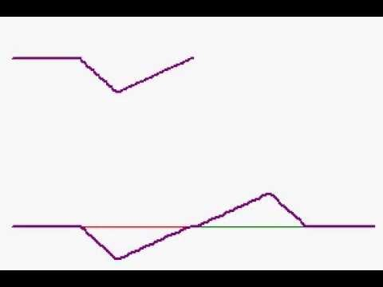

Slide 27
Forces on the End of the Rope
T_{y}
T_{y}
T
T_{y}
T_{x}
F_{g}
T_{x}
F_{wall}
F_{g}
T
F_{wall}

Slide 28
Reasonable?
Remember back in PH 121 (or statics) the book on the table?
Book has a force due to gravity
Table exerts a force equal to m_{book}g on the book

Slide 29
Demo
See if you can feel that you must provide the force

Slide 30
0s
4s
1s
5s
2s
6s
3s
7s

Slide 31
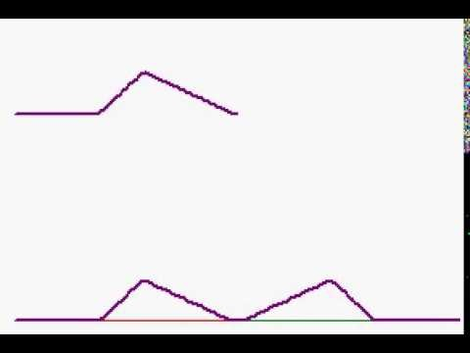

Slide 32
Forces on the End of the Rope
T_{y}
T_{y}
T
T_{y}
T_{x}
F_{g}
T_{x}
F_{g}
T

Slide 33
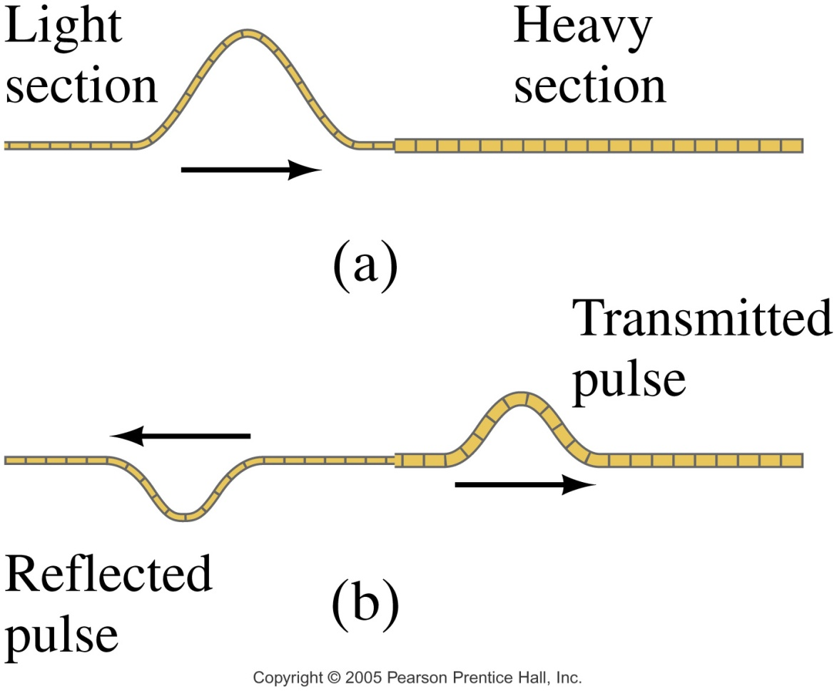
Case 3: Semi-loose End
Now the pulse is partially reflected
RHS rope sees a semi-fixed end point
LHS receives part of the pulse energy
New pulse has been “transmitted”

Slide 34
Forces on the End of the Rope
T_{y}
T_{y}
T
T_{y}
T_{x}
F_{g}
T_{x}
F_{RHS}
F_{g}
F_{RHSl}
T

Slide 35
Consider momentum
When we move from a less dense medium to a more dense medium
Reflected pulse is inverted
Pulse slows down
Which piece is harder to move?

Slide 36
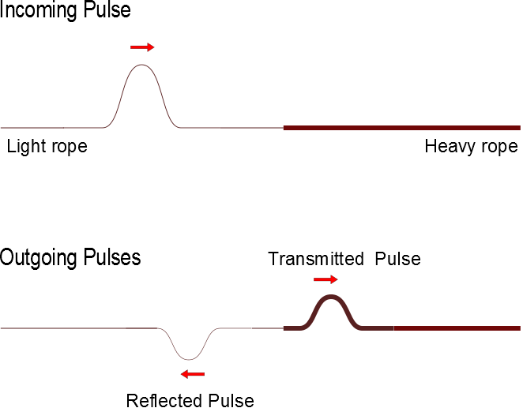
Superposition With and Inverted Pulse

Slide 37
Question 223.5.5 Question 123.22.16
A
B
C

Slide 38
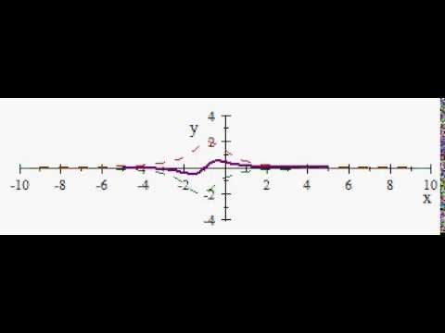

Slide 39
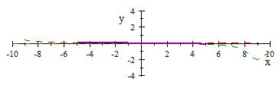

Slide 40
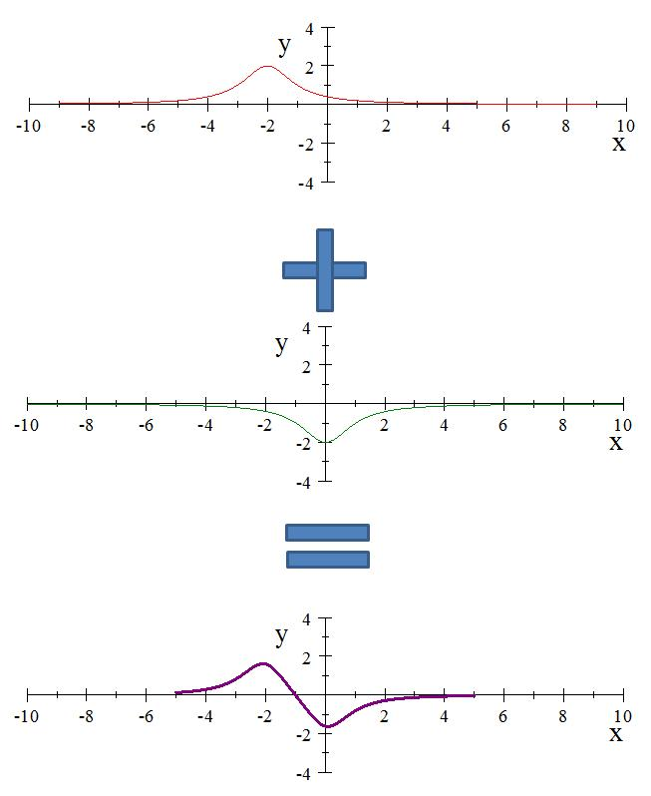

Slide 41
Question 11.3
A
B
C

Slide 42
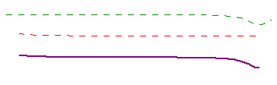

Slide 43
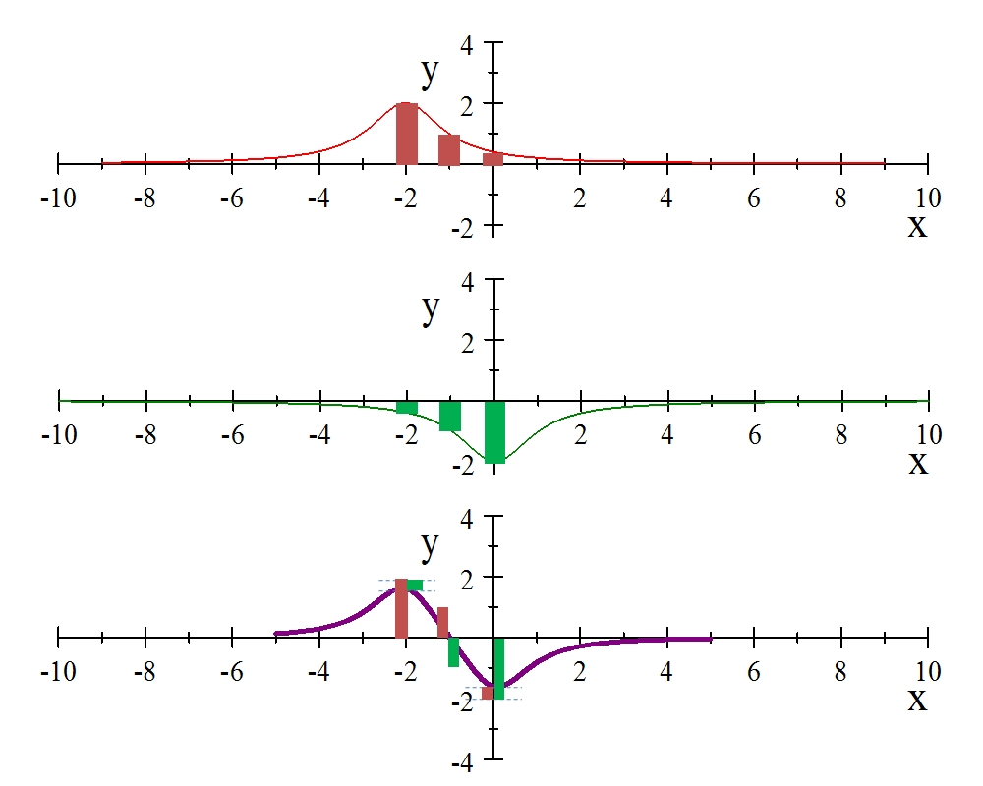

Slide 44
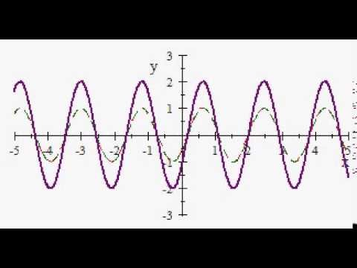

Slide 45
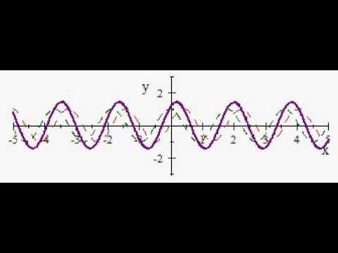

Slide 46
Question 223.5.6
Two pulses travel along a string in opposite directions. One pulse is inverted. When they meet, the string looks flat. Something must have canceled out. What is it?
Wave velocities
Segment velocities
Energy of the waves
Power of the waves

Slide 47
http://commons.wikimedia.org/wiki/File:Destructive_interference1.svg)
http://commons.wikimedia.org/wiki/File:Destructive_interference1.svg)

Slide 48
Question 223.5.7
I add two sinusoidal waves on a string and the two waves have the same amplitude and frequency, but are going the opposite direction. If the phase difference is equal to a half a wavelength, what do I get?
Twice the amplitude of the original waves
Half the amplitude of the original waves
A negative amplitude
Nothing

Slide 49
Question 223.5.8
I add two sinusoidal waves on a string and the two waves have the same amplitude and frequency, but are going the opposite direction. If the phase difference is equal to a whole wavelength, what do I get?
Constructive Interference
Destructive Interference
A negative amplitude
Nothing

Slide 50
Question 223.6.0.1
I have two sinusoidal waves in the same medium. The waves travel the same direction (unlike our class demonstration). If the resultant wave has a larger amplitude than the original waves we call this…
Constructive interference
Destructive interference
A miracle

Slide 51
Question 223.6.0.2
I have two sinusoidal waves in the same medium. The waves travel the same direction (unlike our class demonstration). If the resultant wave has a smaller amplitude than the original waves we call this…
Constructive interference
Destructive interference
Depressing

Slide 52
Question 223.6.0.3
I have two sinusoidal waves in the same medium. The waves travel the same direction (unlike our class demonstration). Sometimes we get constructive and sometimes destructive interference. What makes the difference?
The relative amplitude of the waves
The relative phase constant of the waves
The wavelength of the waves
Random processes

Slide 53
Loud Spot

Slide 54
Loud Spot
Full wavelength farther from the green wave center

Slide 55
Loud Spots

Slide 56
Dead Spot
Half a wavelength farther from the green wave center

Slide 57
Dead Spots

Slide 58
Question 223.8.3
I have two waves coming from speakers in my room. I am sitting 3 wavelengths away from one speaker and 4.5 wavelengths away from the other speaker. I hear..
Twice the normal loudness
4 times the normal loudness
8 times the normal loudness
Practically nothing

Slide 59
Question 223.8.4
I have two waves coming from speakers in my room. I am sitting 3 wavelengths away from one speaker and 6 wavelengths away from the other speaker. I hear..
Twice the normal loudness
4 times the normal loudness
8 times the normal loudness
Practically nothing

Slide 60
3m
2m
2m

Slide 61
End

Slide 62
Anti-Nodes
Nodes

Slide 63
Question 223.4.5.1
If the index of refraction is n = 2, how fast is the light going in the material medium?
Twice the speed of light
Half the speed of light
A quarter the speed of light
1/16 the speed of light

Slide 64
Question 223.4.11 123.22.7
Suppose I have a loud speaker and 1m away from that loud speaker I measure an intensity of 1W /m². What is the sound level?
a) 3dB
b) 10dB
c) 120dB
d) 150dB

Slide 66
Question 223.4.12 123.22.8
Suppose I have a loud speaker and 10m away from that loud speaker I measure an intensity of 0.01 W /m². What is the sound level?
a) 30dB
b) 100dB
c) 120dB
d) 150dB

Slide 67
Question 223.4.13 123.22.9
Suppose I have two French horn players both playing the same note at the same time. I stand a meter away and find that they are each playing with an intensity of 0.00001 W/m². What is the sound level?
a) 0.00001
b) 70dB
c) 73dB
d) 1400dB

Slide 68
Question 223.4.14 123.22.10
You are sitting in church. The speaker is talking into a microphone. The sound system radiates sound with a power of 50W . You are 20m from the sound system output. What is the sound level?
a) 78dB
b) 80dB
c) 100dB
d) 120dB

Slide 69
Question 223.4.15 GR 123.22.11 GR
You are standing outside a Guns & Roses Concert. The concert is in a stadium. You are 40 m from the stadium. You have a sound level meter with you and find that where you stand the sound level is 120dB. How much acoustic power are the “musicians” creating at their output location?
a) 78W
b) 134W
c) 545W
d) 20106W

Slide 70
Question 223.4.16 123.22.12
You are sitting in church. The speaker is talking into a microphone. The sound system radiates sound with a power of 100W . You are 10m from the sound system output. What is the sound level? We can find this using our new SIL equation that includes power and distance.
a)50dB
b) 78dB
c) 109dB
d) 140dB

Slide 71
Question 223.5.1 123.22.13
You are a parent standing at platform 9.75. The Hogwarts Express is just leaving the station. The whistle blows. The engineer (if there is one) hears a perfect middle C (256 Hz). What do you hear as the train leaves?
A higher pitch than 256 Hz
A lower pitch than 256 Hz
Middle C (256 Hz)
Nothing

Slide 72
Inertial Frames
Remember Inertial Reference Frames
The two observers can both take the view that they are stationary
Newton’s laws are all good in either frame
y
v_{x}
A
B
x

Slide 73
Spherical Emitter Setup
Spherical Wave Crests
Detector
Point Source

Slide 74
Moving Detector

Slide 75
Moving Detector

Slide 76
Question 223.5.2 Question 123.22.14
A train passes you while blowing its whistle. Describe the frequency change
The change is nearly instantaneous
The change is gradual, as the train approaches the frequency changes proportionately with the distance from you
The change is gradual, as the train approaches the frequency changes inverse proportionately with the distance from you
Can’t tell

Slide 77
Question 223.5.3 Question 123.22.15
You are sitting on the Hogwarts Express. It is just leaving the station. The whistle blows. The engineer (if there is one) hears a perfect middle C (256 Hz). What do you hear as the train leaves?
A higher pitch than 256 Hz
A lower pitch than 256 Hz
Middle C (256 Hz)
Nothing

Slide 78
Question 225.5.4
Often a single jet will create two sonic booms, why?
One is from the plane and one is from the condensation trail that follows the plane
The nose and the tail both act as wave sources
One is from the plane and one is a Newton's third law reaction

Slide 79
Question 223.5.4.1
You are playing your Irish tin whistle at 440Hz. Your friend runs toward you at 10m/s. What frequency does your friend hear? (take 343m.s as the speed of sound)
453.8Hz
427.1Hz
453.2
427.5

Slide 80
Sonic Boom Setup
v_{s}
θ
s_{n}
s_{o}
s₁
s₂
s₃
s₄
v_{s}t

Slide 81
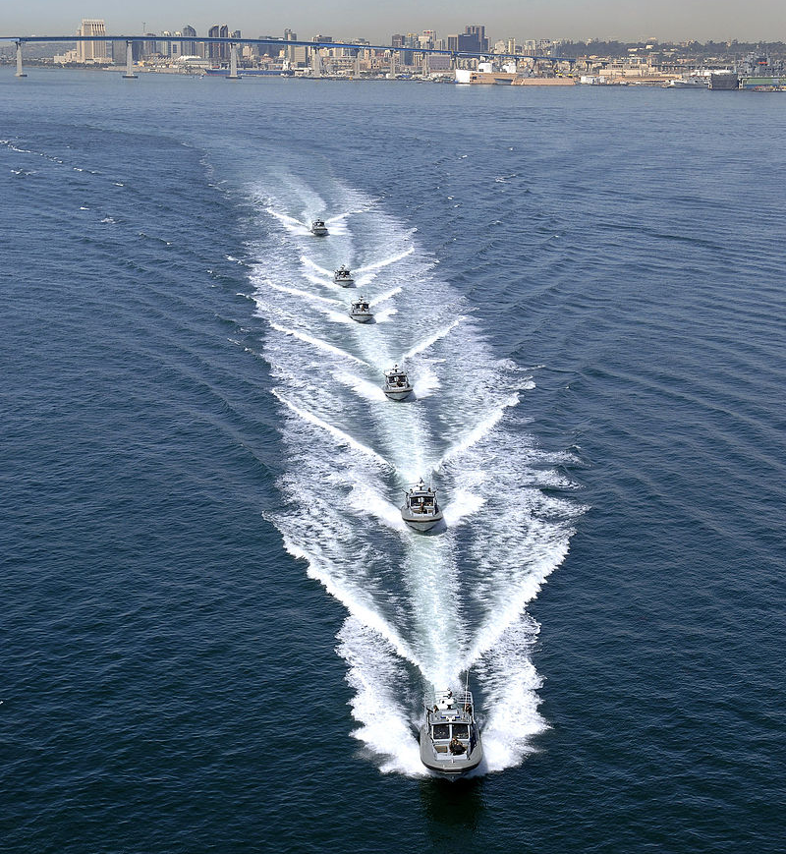

Slide 82
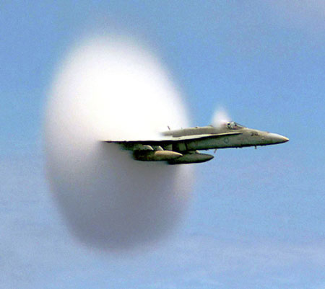

Slide 83
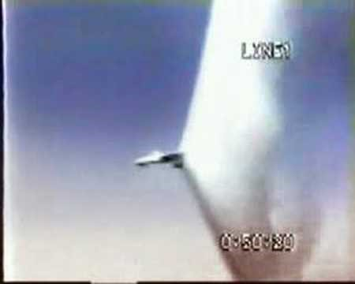

Slide 84
Top: Normal 'dark' spectral line positions at rest. Middle: Source moving away from observer. Bottom: Source moving towards observer. (Public domain image courtesy NASA: http://www.jwst.nasa.gov/education/7Page45.pdf)

Slide 85
High Redshift Galaxy Cluster shown here in false color from the Spitzer Space Telescope. (Public domain image courtesy NASA/JPL-Caltech/S.A. Stanford (UC Davis/LLNL)

